Slide 1

Children and Sleep

Slide 2
You take your 3-year-old to the playground with the hope that running him/her ragged will tire him/her out by 8 p.m. and allow you to enjoy a relaxing evening and maybe sleep in a bit. But the plan backfires. Your boisterous child is still bouncing off the walls at 9 p.m., finally falls asleep later that night, and then wakes up full of energy and ready to play at 6 a.m.
Sound familiar?

Slide 3

Parents may think getting through the night with a new born was tough, but getting a young child to sleep can be a challenge that leaves even the most patient mums and dads exasperated. When young children don't get enough sleep it can affect their mood, behaviour, eating habits, and ability to focus during the day.

Slide 4
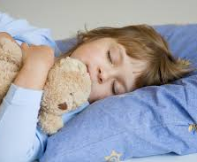
Sleep is a vital need, essential to a child’s health and growth. Sleep promotes alertness, memory and performance. Children who get enough sleep are more likely to function better and are less prone to behavioural problems and moodiness. That is why it is important for parents to start early and help their children develop good sleep habits.

Slide 5
How much sleep should my child get?
Each child is different and has different sleep needs. This chart presents recommended hours of sleep that includes naps for children up to five years of age.
Age Hours of Sleep
0-2 months 10.5-18
2-12 months 14-15
1-3 years 12-14
3-5 years 11-13
5-12 years 10-11

Slide 6
Children need and thrive on routine!
The tip for good sleeping habits in children is to follow a nightly routine. A bedtime ritual makes it easier for your child to relax, fall asleep and sleep through the night.
Typical Bedtime Routine
1.Have a light snack
2.Take a bath.
3.Put on pyjamas.
4.Brush teeth.
5.Read a story.
6.Make sure the room is quiet and at a comfortable temperature.
7.Put your child to bed.
8.Say goodnight and leave.

Slide 7
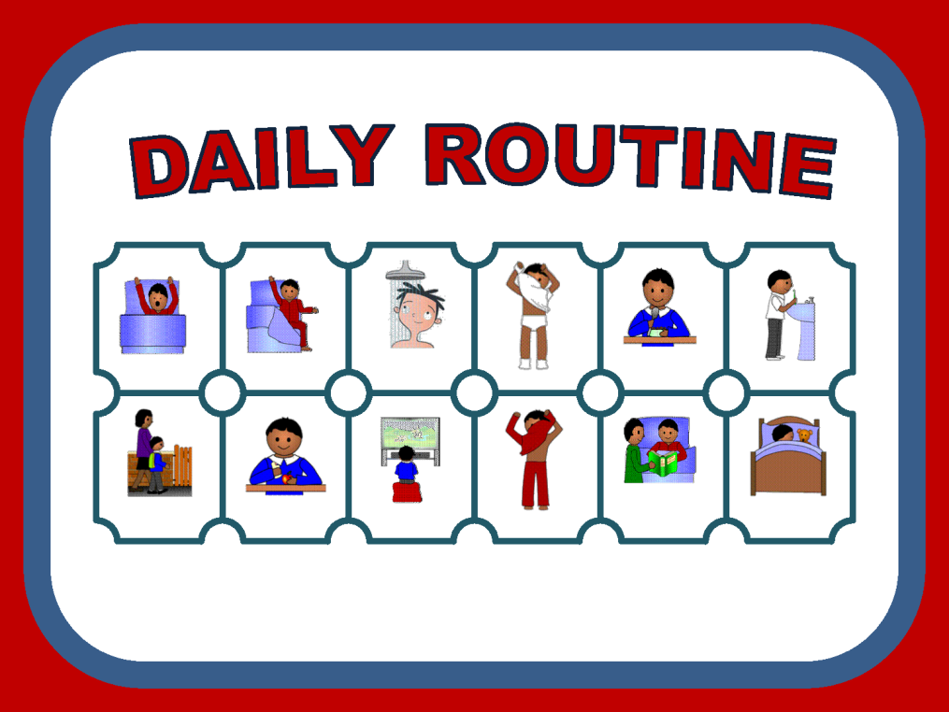
Helpful tips!
•Make bedtime the same time every night.
•Make bedtime a positive and relaxing experience without TV or any kind if electronic device. (According to one recent study, TV viewing prior to bed can lead to difficulty falling and staying asleep. Save your child’s favourite relaxing, non-stimulating activities until last and have them occur in the child’s bedroom).
•Keep the bedtime environment the same (e.g. light, temperature) the same all night long.

Slide 8
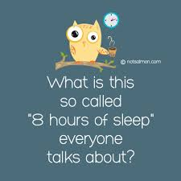
Encourage Children To Fall Asleep On Their Own.
Have your child form positive associations with sleeping. A child should not need a parent to help him/her fall asleep. One recent study demonstrated that having your child sleep in your bed puts them at risk for suffocation or strangulation. The child who falls asleep on his or her own will be better able to return to sleep during normal night time awakenings and sleep throughout the night.

Slide 9
Discourage Night time Awakenings
When you go to your child’s room every time he or she wakes during the night, you are strengthening the connection between you and sleep for your child. Even babies who are held and cuddled when they wake in the middle of the night soon learn to expect this and do not learn to go back to sleep on their own. Except during conditions when the child is sick, has been injured or clearly requires your assistance, it is important to give your child a consistent message that they are expected to fall asleep on their own.

Slide 10
Getting up after bedtime
Try these tips:
Avoid boisterous play as well as watching TV and using computers, smart phones or tablets close to bedtime. These activities can make it harder for your child to settle.
Establish a consistent, calming bedtime routine.
Make sure your child’s room is cool, quiet and dark.
Before leaving the room, check that your child has everything they needs for sleep, such as their favourite cuddly toy or blanket. Remind them to stay quietly in bed.
Try not to go in to your child if they call after you’ve turned the light out. If you do, they might try the same thing again next bedtime.
If your child gets out of bed, calmly ask them to go back to bed. Say that you’re just in the other room. Repeat this firmly and quietly over and over until your child doesn’t get up again.

Slide 11
However…
Sometimes your child might actually need something.
For example, If your child is scared of a monster under the bed, quickly check and tell your child there are no monsters. Your child might settle after this.
If your child is scared of the dark, think about using a night-light.

Slide 12
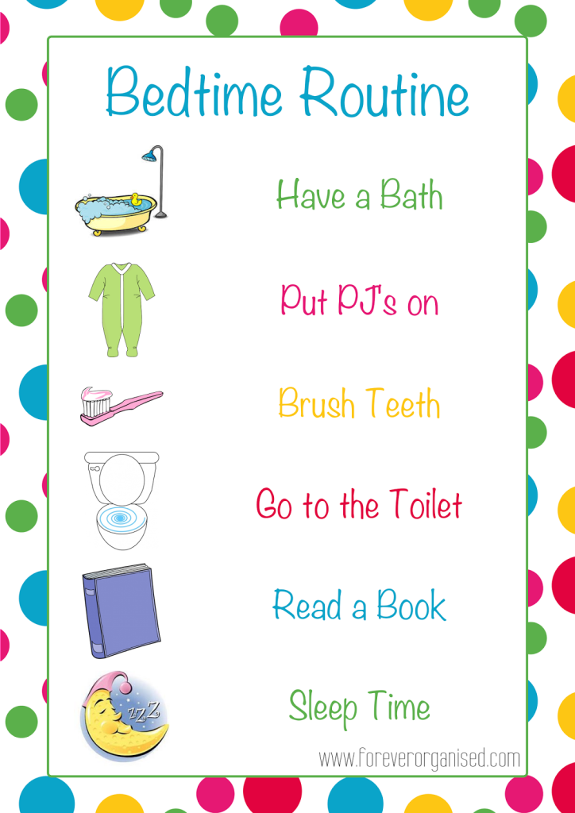
What time is bedtime?
What time do you want them to get up?
If your child should have 12 hours sleep and you need them up about 7.30 am they should be in bed by 7 pm.
Think about the routine of bath, pyjamas, teeth, glass of water etc.
Get them into bed and read them a story.
If this will take about 30 mins you will aim to begin this process around 6.30 pm.

Slide 13
Children will sleep longer at night if they do not take a nap.
For young children, nap and night time sleep are both necessary and independent of each other. Children who nap well are usually less cranky and sleep better at night. Although children differ, after six months of age, naps of 1/2 to two hours duration are expected and are generally discontinued between ages 2-5 years. Daytime sleepiness or the need for a nap after this age should be investigated further.

Slide 14
Some Common Myths About Children And Sleep
Parents should wait until a child is fully asleep before putting a child to bed.
Put children asleep on their stomachs.
Babies should be put to sleep on their backs. According to the “Back to Sleep” program, this lowers the risk of dying from Sudden Infant Death Syndrome (SIDS). It is also recommended that parents should avoid placing young children to sleep on a sofa, pillow, soft mattress or other soft surfaces.
Children should be put to bed when they are drowsy, but awake.

Slide 15
Sleep problems and what to do
Nightmares
Sleep Terrors/Sleep Walking
Nightmares often occur at times of transition, stress or change in a child’s routine. They usually occur later in the night and are remembered the next day. Fortunately, nightmares tend to go away naturally. Encouraging your child to talk about the nightmare, discussing comforting images before bedtime and avoiding television immediately before bedtime are strategies that assist in alleviating nightmares.
Sleep Terrors/Sleep Walking occur most frequently from 4-8 years of age. These sleep disruptions occur during the early part of the night. The child is both asleep and awake at the same time and often has no memory of the event the next day. Waking or comforting the child is usually not helpful as it prolongs the event. Be sure your child’s room and your house is safe. Most important, encourage him/her to get enough sleep.

Slide 16
Sleep Apnoea
Narcolepsy
Sleep Apnoea is a serious disorder in which there are pauses in breathing during sleep. Children with sleep apnoea may snore loudly, experience restless sleep and be sleepy during the day. Enlarged tonsils or adenoids, allergies, weight problems and other medical problems may contribute to sleep apnoea. There are many ways to treat apnoea, so it is important to see your doctor or visit a sleep centre for a diagnosis and treatment.
Narcolepsy is often first noticed in puberty, but may occur as early as ten years of age. Children with narcolepsy experience excessive daytime sleepiness and uncontrollable “sleep attacks,” even when they get enough sleep. Children with narcolepsy should be diagnosed by a doctor.

